Slide 1
The Author’s journey
ASME

Slide 2
Where to begin
There are two options for a new author to begin the process. They can either go in through our website @asme.org or they can simply visit our platform @https://asmedigitalcollection.asme.org/journals Under each of our Journals, there is an option to “Submit Paper”.
Either way they navigate, it will bring them to our Journal Tool where they will either create a new account or log in with their existing credentials.

Slide 3
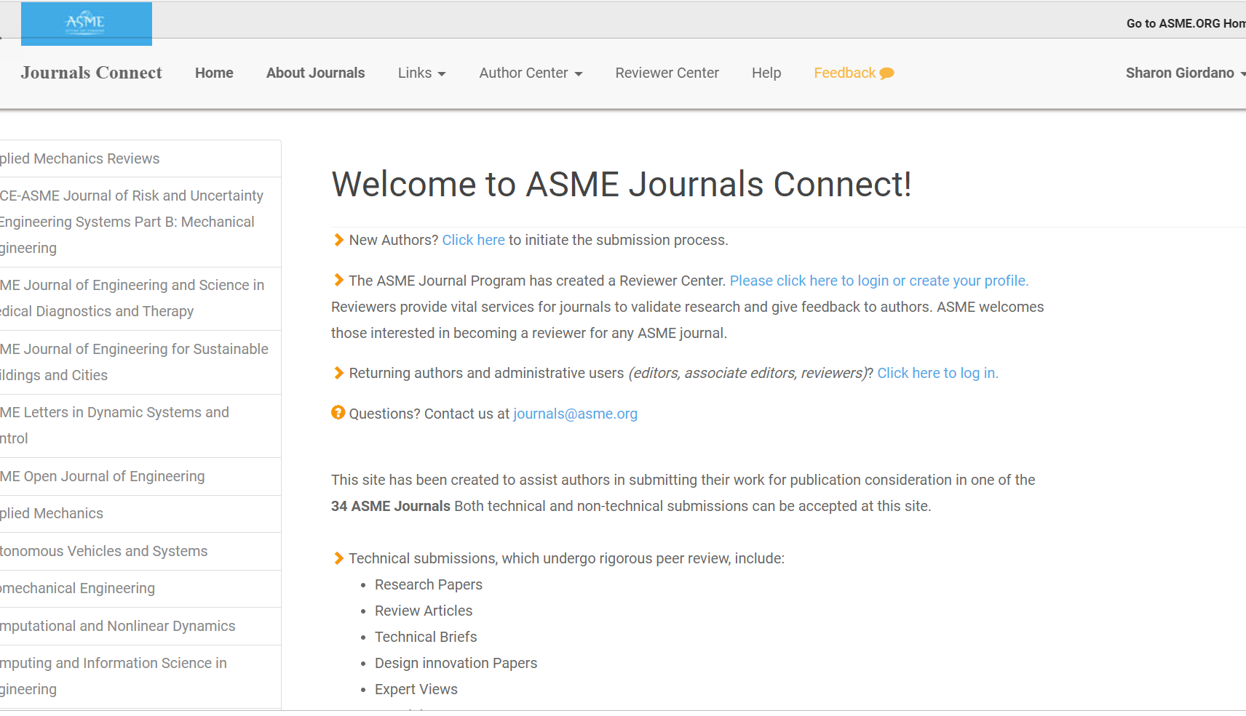
The journal tool

Slide 4
The process
Once an account is either created or an Author signs into their existing account, their process will begin, and they will see the following:
They will either see an existing paper, or they will just click on Submit Paper to submit a new paper

Slide 5
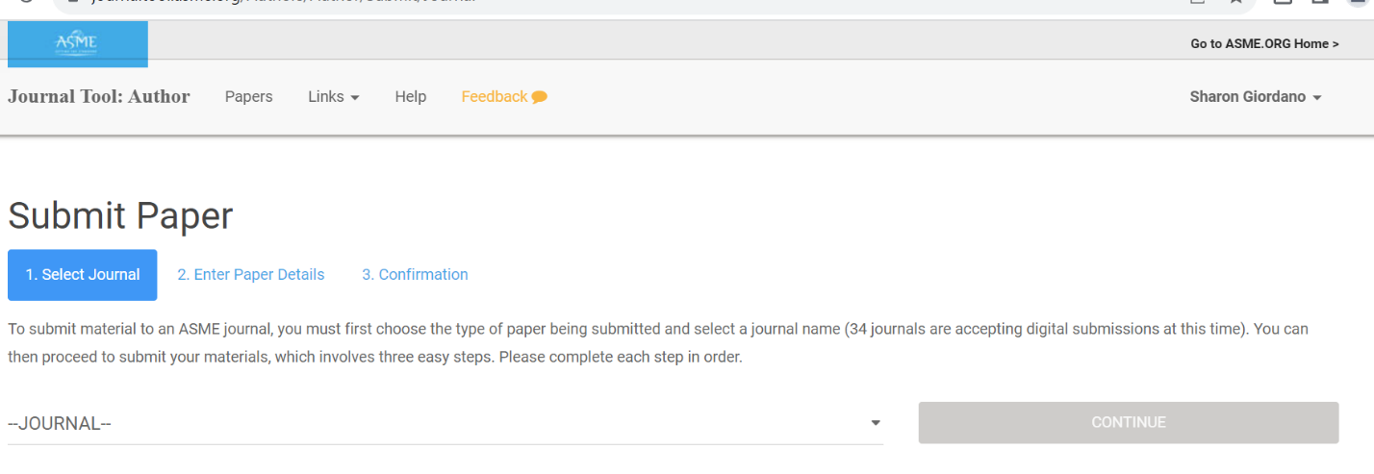
The process
Since authors can submit an OA or NonOA paper in any of our 33 hybrid journals, including our new ASME Open Journal of Engineering, they would need to select which journal below:

Slide 6
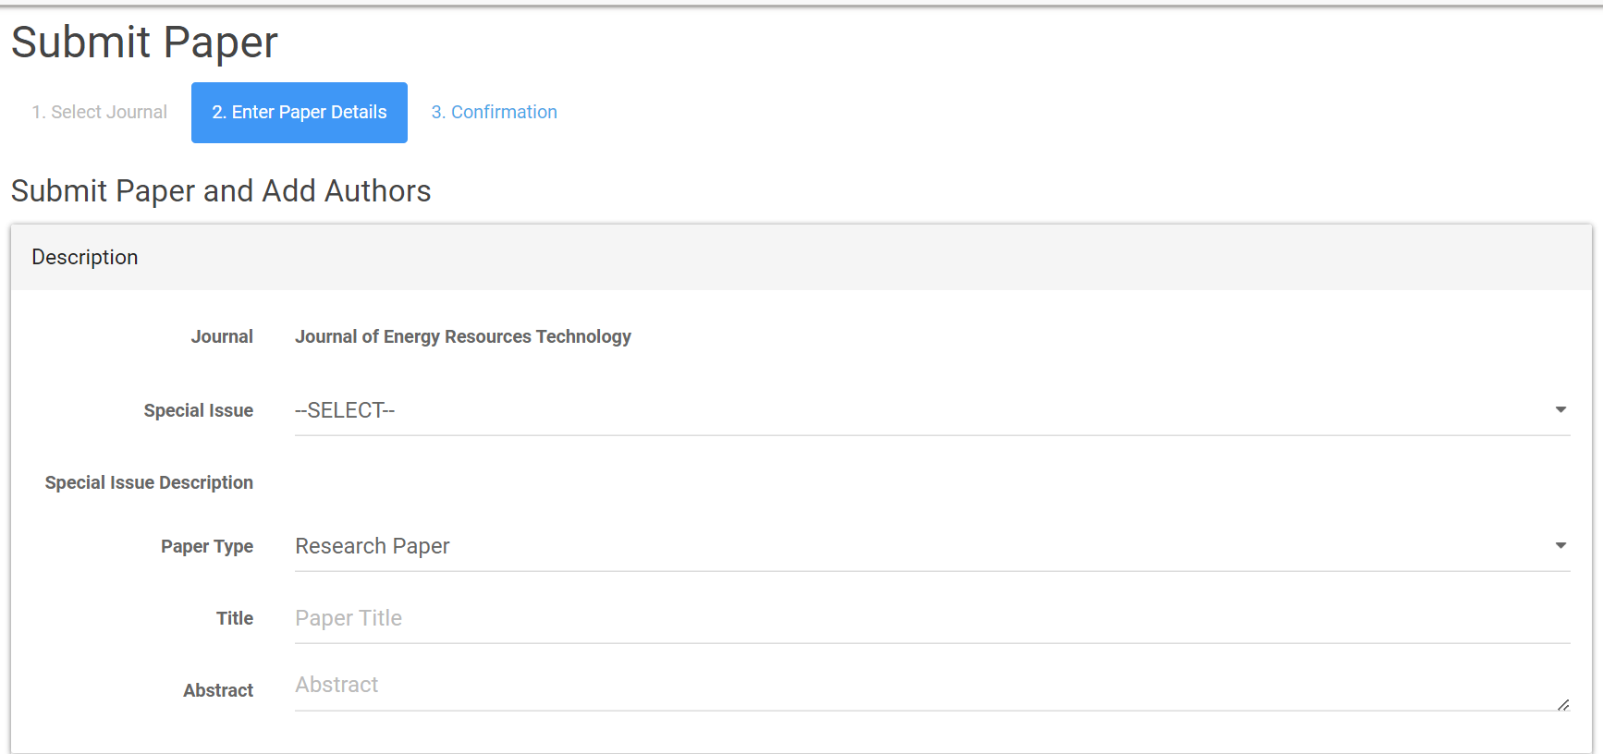
The process
The author would continue to answer the below questions pertaining to their paper:

Slide 7
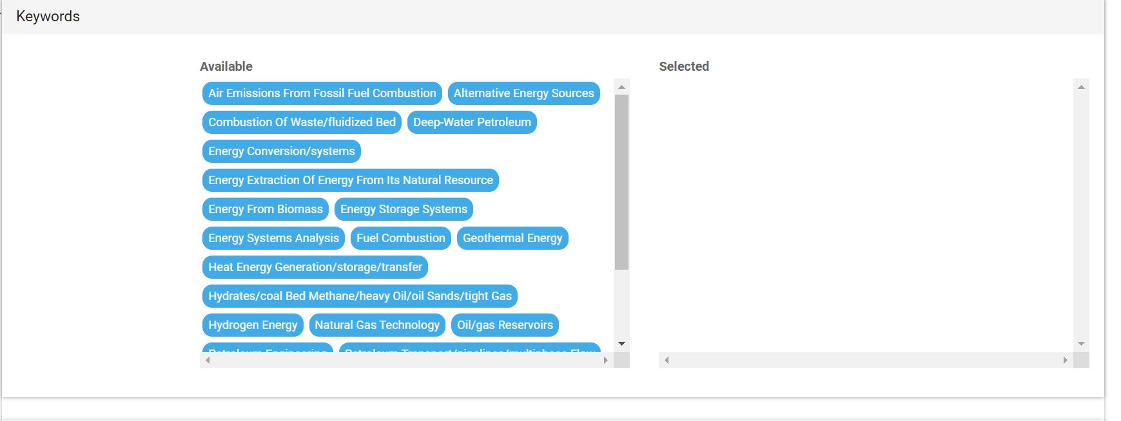
The process
The author would continue to answer the below questions pertaining to their paper:

Slide 8
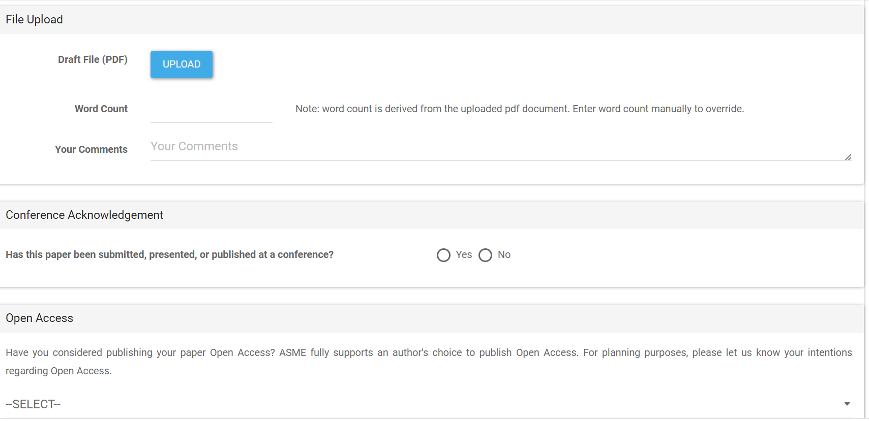
The process
Below is where the author would upload their paper and continue to answer the below questions, including a quick Open Access survey

Slide 9
The process
This is the next series of questions asked…..

Slide 10
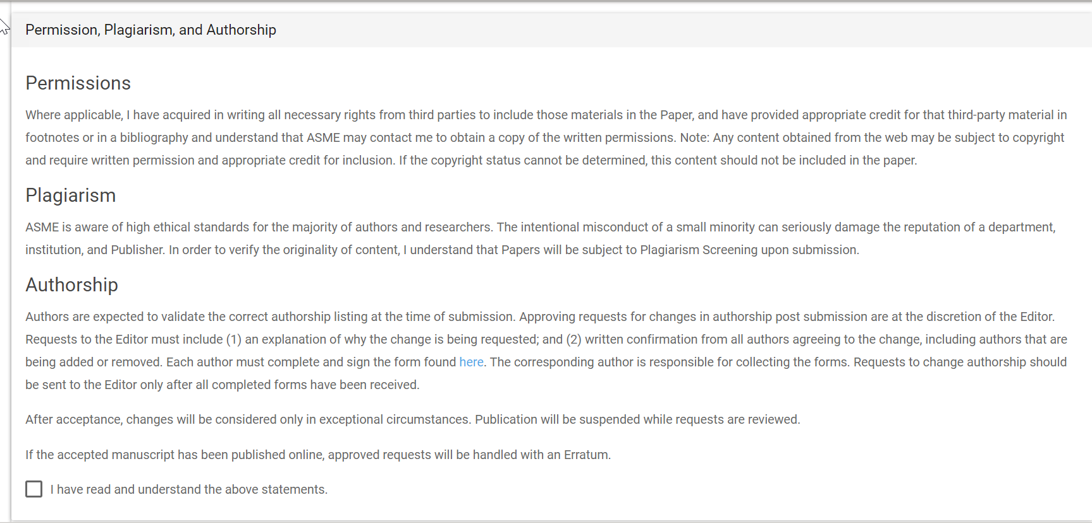
The process
This is the next series of questions asked…..

Slide 11
The process
This is the next series of questions asked…..
The process is now complete, and the author will be brought to the Confirmation page

Slide 12
The process is now complete, and the author will begin receiving emails with the status of their paper. They can also log into the journal tool and see updates there.
Once the paper is accepted, the author will now have the option to choose whether they intend to publish OA or NonOA

Slide 13
Publishing open access
If a University enters into a transformative agreement with ASME, the Librarian supplies us with all domains associated. These papers are flagged, and fees are waived. The verbiage above alerts the author that if an agreement is in place, fees will be waived.

Slide 14
Quick guide for manuscript preparation
ASME's Guide for Journal Authors
Authors: Why Publish in ASME Journals?
Writing a Research Paper or Technical Brief
Sample Nomenclature
Sample Published Paper

Slide 15
summary
When you publish in an ASME journal, your work appears in an established, highly respected journal that is read, shared, and cited by an international community of engineers who value your contributions to the field.

Slide 16
THANK YOU
Paul Hiatt
ASME
Publishing Sales Representative
hiattp@asme.org

