Slide 1
Università di Bologna
Chloe Turner
Library Trainer
chloe.turner@sagepub.co.uk

Slide 2
Session outline
Introduction to SAGE Research Methods
SAGE Research Methods and the research process
In practice: a literature review
Platform demonstration: finding content and using tools
Your questions

Slide 3
SAGE Research Methods is a database containing over 5,000 resources, dedicated to the subject area of Research Methods. It supports all stages of the research process from: writing a research question, conducting a literature review, choosing the best research methods, analysing data, to writing up your results and thinking about publication.

Slide 4
Content
Content is written by researchers, who largely are research methods faculty from a broad range of disciplines.
Content is checked for quality by experts.

Slide 5
SAGE Research Methods Core
1000+ books, reference works, journal articles, and 75 videos.
Project Planner
Research tools
SAGE Research Methods Datasets
231 datasets (Datasets 1)
301 datasets (Datasets 2)
Research tools
Datasets are sample datasets that can be used to support the teaching and independent learning of quantitative and qualitative analytical methods.
SAGE Research Methods Video: Practical Research & Academic Skills
61+ hours of video (442 videos)
Research tools
Streaming video collection covering the practical skills needed to successfully conduct original research.
SAGE Research Methods Cases
676 case studies (Cases 1)
1500+ case studies (Cases 2)
Research tools
Cases are detailed records of how real research projects were conducted, showing the challenges and successes of doing research, written by the researchers themselves.
SAGE Research Methods Video
120+ hours of video (484 videos)
Research tools
Streaming video collection that brings research methods to life, covering the full research methods and statistics curriculum.
SAGE Research Methods Video: Data Science, Big Data Analytics, & Digital Methods
120+ hours of video (442 videos)
Research tools
Streaming video collection covering a range of data science methods, the issues and challenges of using big data and digital methods, and the intersection of computer science and the social sciences.

Slide 6
SAGE Research Methods and the research process

Slide 7
‘Choosing Among Methods’ (Book Chapter from Needs Analysis)
‘How do I choose between different methods?’ (Video)
‘Developing a researchable question’ (Project Planner)
‘Research question’ (Encyclopaedia Entry from The SAGE Encyclopaedia of Qualitative Research Methods)
Writing your research question
Choosing your methods
Carrying out your research
Analysing your results
Thinking about publication
Writing up your findings
‘Conversation Analysis and Discourse Analysis’ (Book)
‘A discourse analysis approach to interview data’ (Dataset)
Doing interviews (Book)
‘How should a real time online interview be incorporated into a research design?’ (Video)
‘The Experience of Female Football Fans in England: Conducting One-to-One Interviews and the Reliability of Memory’ (Case)
Writing for publication (Book)
‘Publication and Dissemination’
(Book Chapter from Participatory Research with Children and Young People)
‘What advice do you have for writing up my research project?’ (Video)
The Essential Guide to Postgraduate Study (Book)

Slide 8
To access the resources listed on the previous slide:
https://methods.sagepub.com/reading-lists/the-research-process/34495

Slide 9
SAGE Research Methods in practice: helping researchers learn how to conduct a literature review

Slide 10
‘Literature reviews’ : Entry from the Encyclopedia of Research Design
Need to prepare agenda
How to use this
resource
If this is their first literature review, ask students to use Card’s seven dimensions as the structuring framework or starting point of the review to actively engage them in the process
Ask students to annotate a real literature review according to Card’s seven dimensions
Ask students to focus on one dimension and review a small number of literature reviews, critically analysing different approaches
Ask students to critique their own work (perhaps a literature review they have written before)
“
Literature reviews can vary along at least seven dimensions…
Focus
Goals
Perspective
Coverage
Organization
Methods of Synthesis
Audience
”

Slide 11
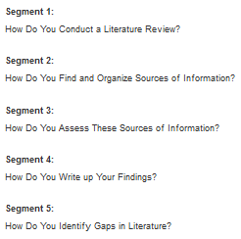
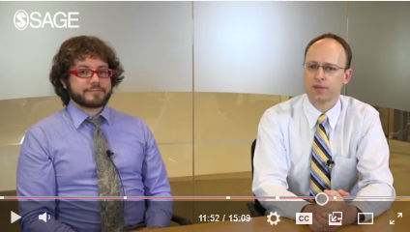
‘An Introduction to Literature Reviews’: Video
‘Assessing the Impact of a Community Program for Young Girls: Literature Review, Questionnaire Survey Methods, and Survey Data Analysis’: Case

Slide 12
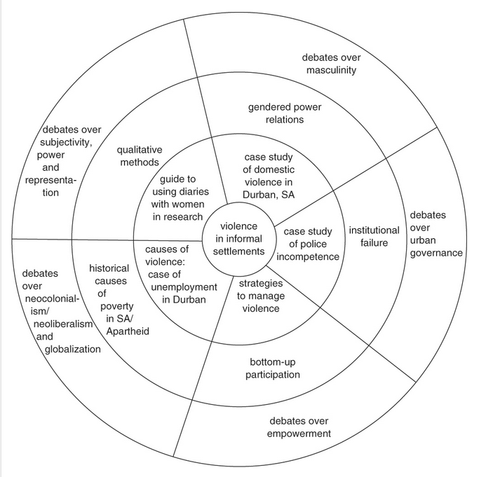
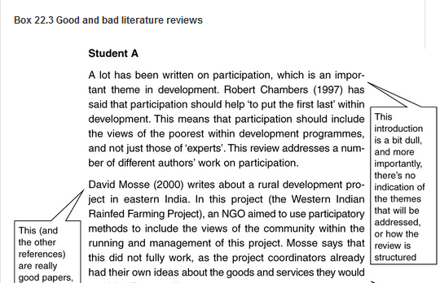
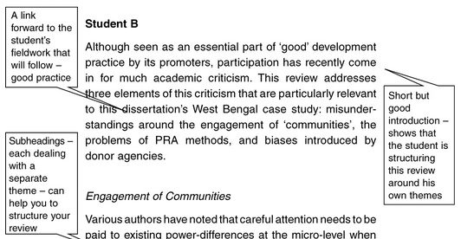
‘Literature reviews and bibliographic searches’: Book Chapter from Doing Development Research
Highlights of this resource
The literature map
Dos and don’ts for the literature review process
Provides common mistakes to help students avoid them
Comparisons of good and bad examples of literature reviews
Strategies for evaluating different types of resources (critical thinking)
Discussion questions encourage students to reflect on what they’ve read
Written in an easy-to-understand format, but information and tips are relevant to all students and researchers

Slide 13
To access the resources on literature reviews: https://methods.sagepub.com/reading-lists/literature-reviews/34496

Slide 14
SAGE Research Methods in practice: Activity

Slide 15
Activity: Resources for ‘literature review’
Resource name & resource type | Search terms | I like this resource because… | I could use this by…
‘Literature reviews’ Entry from the Encyclopedia of Research Design | “Literature review” Filtered on encyclopedia reference content type. | The resource shows that literature reviews can vary along at least 7 dimensions. Thinking about these dimensions helps to make the literature review less daunting, and for the research questions and aims to be thought about critically. | Students and researchers could use these seven dimensions as the structuring framework or starting point of their literature review to actively engage in the process. Students and researchers could focus on 1 dimension and review a small number of literature reviews, critically analysing different approaches.
Video – Segment 2 ‘Do I Do My Literature Review Before I Decide on Which Methods I’ll Use?’ in Research Design | “Literature review” Filtered on video content type. | Helps students and researchers to understand the role and position of the literature review in the whole research process. | The author talks about the concept of social class, in relation to the literature review and research design, which helps to give an understanding about how this is applied to a real topic. This video could be used to help students and researchers break down their own topic into more manageable sections.

Slide 16
Want to learn more?
If you’d like to learn more about SAGE Research Methods, we recommend the following resources from our Training Resource Centre:

Slide 17
Please may I invite you to: complete our short survey I would really appreciate your thoughts, to ensure our training is as effective and beneficial as possible to our customers.

Slide 18
Thanks for listening!
Chloe Turner
chloe.turner@sagepub.co.uk
Library Trainer

